Slide 1
MODULE II

Slide 2
Syllabus of module 2
Classes fundamentals
Objects
Methods
Constructors
Parameter passing
Overloading
Access control keywords.

Slide 3
Creating and Using Classes in Java
Syntax of Class :
class classname
{
type instance-variable1;
type instance-variable2;
// ...
type instance-variableN;
type methodname1(parameter-list)
{ // body of method }
type methodname2(parameter-list)
{ // body of method }
// ...
type methodnameN(parameter-list)
{ // body of method }
}

Slide 4
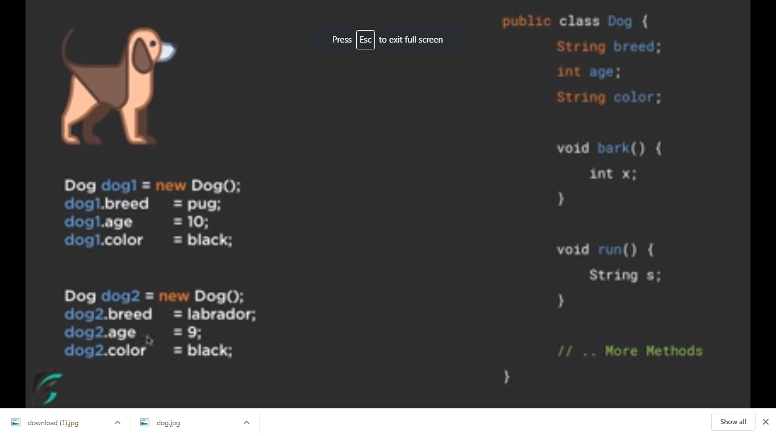

Slide 5
Class defines a new data type.
Once defined, it can be used to create objects of that type.
A class is a template for an object, and an object is an instance of a class.
The methods and variables defined within a class are called members of the class.
The variables, defined within a class are called instance variables. The data for one object is separate and unique from the data for another.
Methods determine how class data can be used.

Slide 6
Example:
Define a class Box which defines three instance variables: width, height, and depth.
class Box
{
double width;
double height;
double depth;
}
This class defines a new data type called Box

Slide 7
Declaring a class Object
An object is an instance of a class.
Declaration of an object is a two-step process :
  Declare a variable of the class type.
  Acquire an actual, physical copy of the object and assign it to that variable. This can be done using the new operator.
The new operator dynamically allocates memory for an object and returns a reference to it. This reference is the address in memory of the object allocated by new. This reference is then stored in the variable.
Example :
Box mybox; // declare reference to object
mybox = new Box(); // allocate a Box object
The above statements can also be written as follows
Box mybox = new Box();

Slide 8
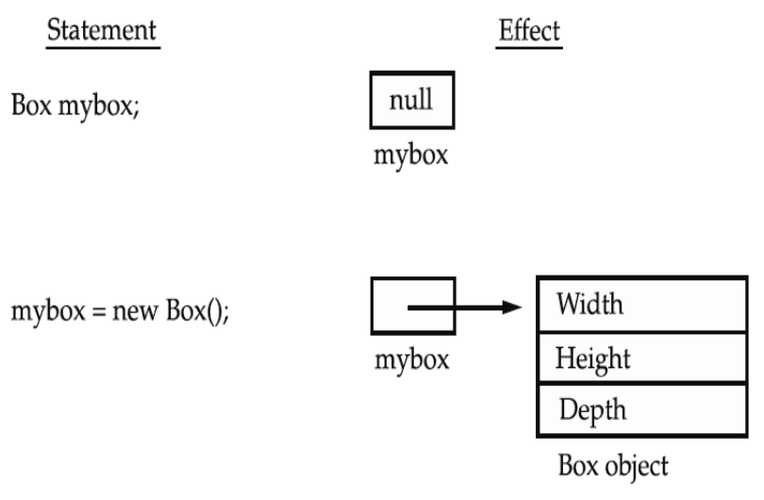

Slide 9
To access the variables dot (.) operator is used.
Example : assign the width variable of mybox the value 100
mybox.width = 100;
If we have two Box objects, each has its own copy of depth, width, and height. Changes to the instance variables of one object have no effect on the instance variables of another.
Write a program to find the volume of a box, whose dimensions are given

Slide 10
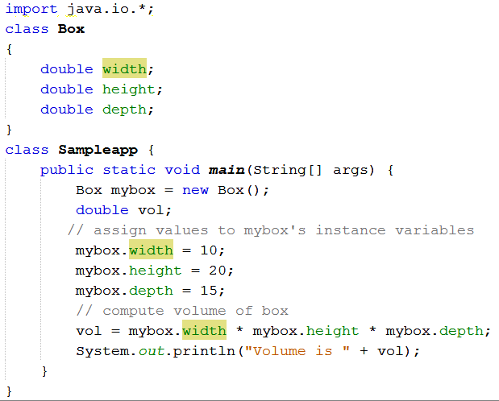

Slide 11
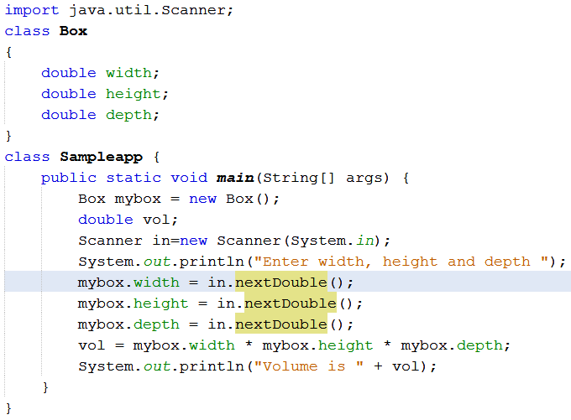

Slide 12
Assigning Object Reference Variables
Example:
Box b1 = new Box();
Box b2 = b1;
A subsequent assignment to b1 will simply unhook b1 from the original object without affecting the object or affecting b2.
Example: Box b1 = new Box();
Box b2 = b1;
// ...
b1 = null;
Here, b1 has been set to null, but b2 still points to the original object.

Slide 13
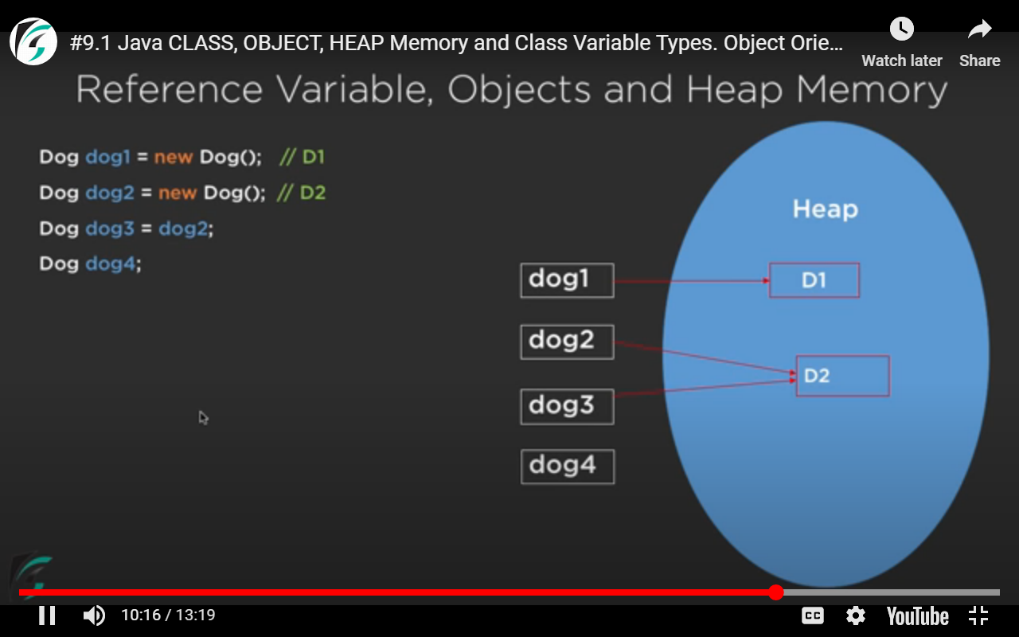

Slide 14
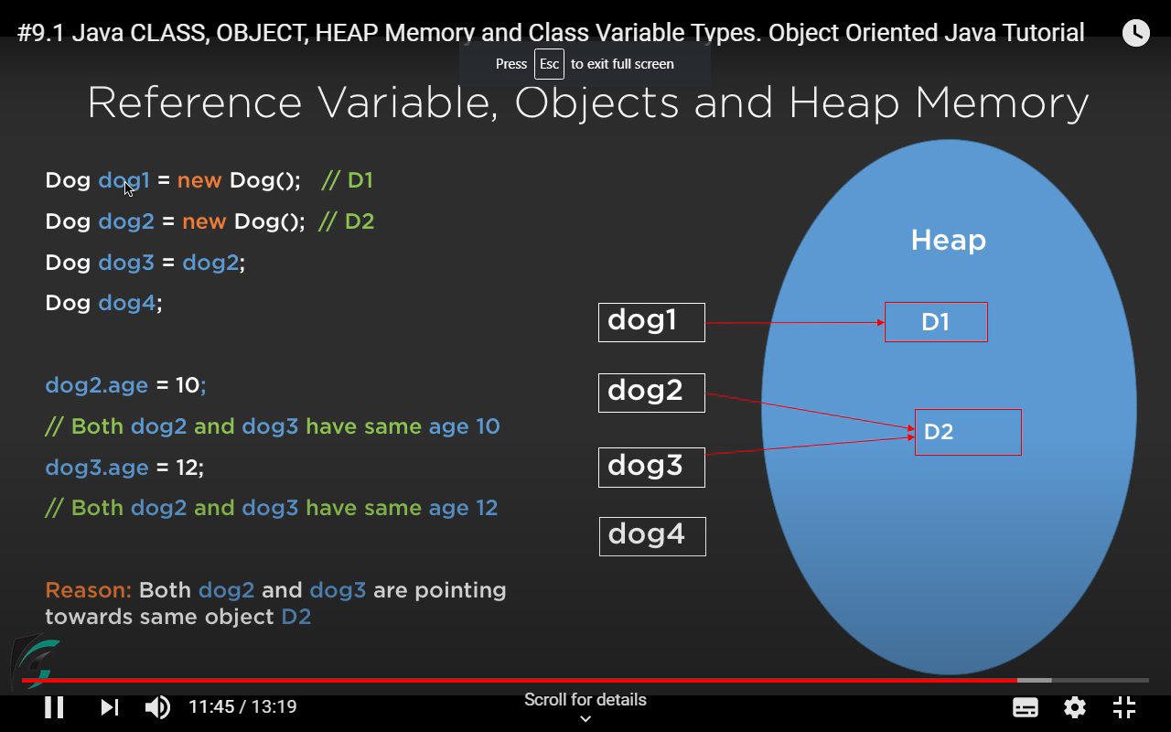

Slide 15
class Sampleapp {
public static void main(String[] args) {
Box mybox = new Box();
Box b2=mybox;
System.out.println("Enter width, height and depth ");
mybox.width = 2;
mybox.height =2;
mybox.depth = 3;
b2.width=12;
System.out.println("Width of box mybox : "+mybox.width);
System.out.println(“Depth of box mybox : "+b2.depth);
}
//output
Width of box mybox :12
Depth of box mybox : 3
}

Slide 16
Methods
Syntax : type name(parameter-list)
{
// body of method
}
Methods that have a return type other than void return a value to the calling routine
  Syntax :
  return value;
  The type of data returned by a method must be compatible with the return type specified by the method.
  The variable receiving the value returned by a method must also be compatible with the return type specified for the method.
The name of the method should be a legal identifier.

Slide 17
Q1)Write a program to find the volume of a box using method.
Q2)Write a program to find the volume of a box (whose dimensions are given) using method with a return type.
Q3)Write a program to find the volume of a box(whose dimensions are given) using parameterized method.

Slide 18
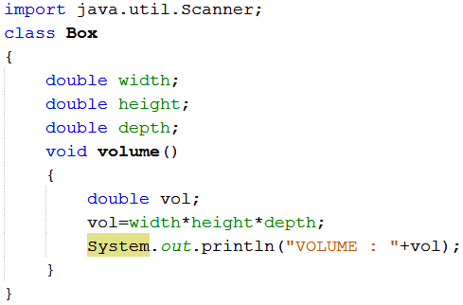
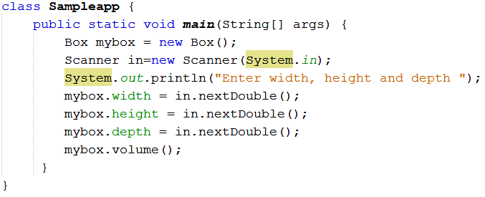

Slide 19
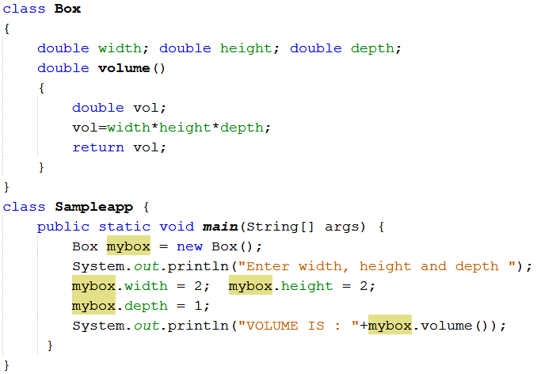
Q2

Slide 20
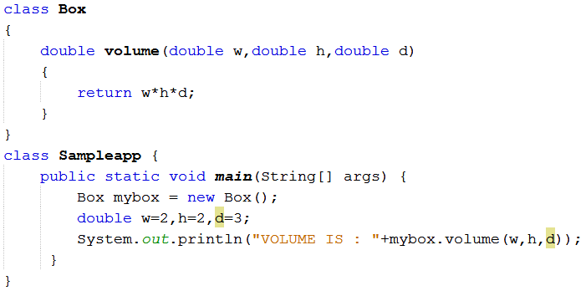
Q3

Slide 21
TUTORIAL 3
1. Create a class circle with data field radius. Calculate the area and perimeter using methods with return type.
2. Create a class student with fields rollno, name and marks of three subjects. Calculate the total marks and percentage obtained by the student.

Slide 22
Argument/Parameter Passing
Two ways to pass an argument to a method :
  call-by-value (or pass by value)
  call-by-reference (or pass by reference)
Call by value : If we call a method by passing a value, it is known as call by value. The changes being done in the called method, is not affected in the calling method.
Call by Reference: Here original value is changed if changes are made in the called method. If we pass object in place of any primitive value, original value will be changed.

Slide 23
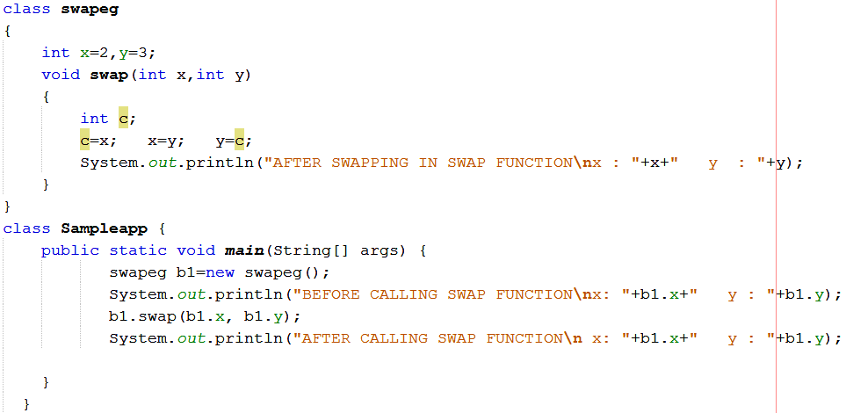
Example for Pass by value

Slide 24

Output:

Slide 25
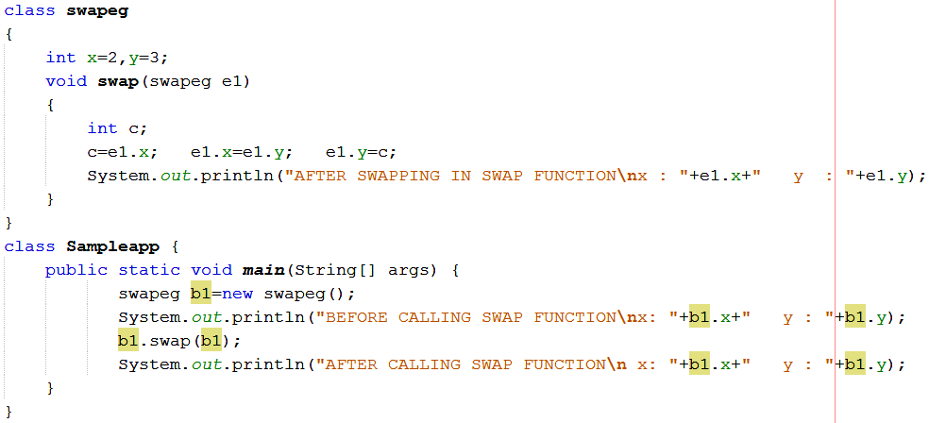
Example for Call By Reference (here object is passed as parameter)

Slide 26

Output

Slide 27
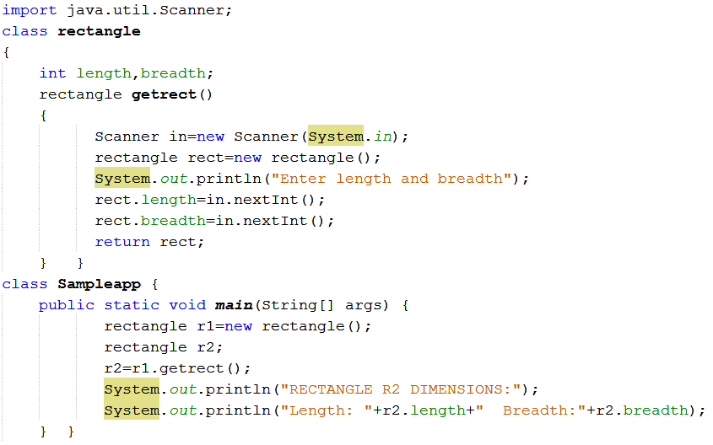
Returning Objects in Methods

Slide 28
Constructors
Used to initialize objects when they are created.
It has the same name as the class in which it resides.
It is syntactically similar to a method.
The constructor is automatically called immediately after the object is created.
Constructors have no return type.
Java supports 2 types of constructors:
Default Constructor - does not have an argument.
Parameterized Constructor - A constructor having parameter is called parameterized constructor.

Slide 29
Default Constructor:
A default constructor does not have an argument.
It provides default values to the object.
If no constructor is designed by the user explicitly, java compiler implicitly provides a default constructor.
  JVM calls that system defined default constructor at the time of object creation.
If we define a default constructor, JVM will call the user-defined default constructor.

Slide 30
Parameterized Constructor:
The parameterized constructor has parameters.
  The values for these parameters must be provided when the constructor is called.
This type of constructor is used to provide different values for the data members of different objects.
The programmer has to explicitly define such a constructor. Java compiler never provides any parameterized constructor, unlike default constructor.
Calling the parameterized constructor without defining it will generate a compile-time error.

Slide 31
Q1. Write a program to find the volume of a box using constructor
Q2. Write a program to find the volume of a box using parameterized constructor

Slide 32
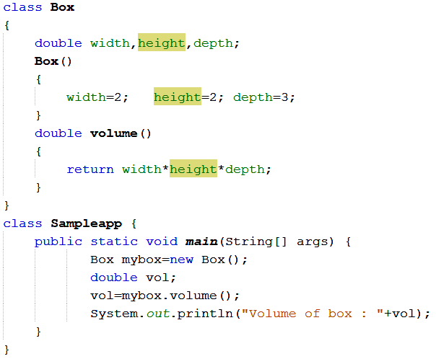
Q1 (Example of Default Constructor)

Slide 33
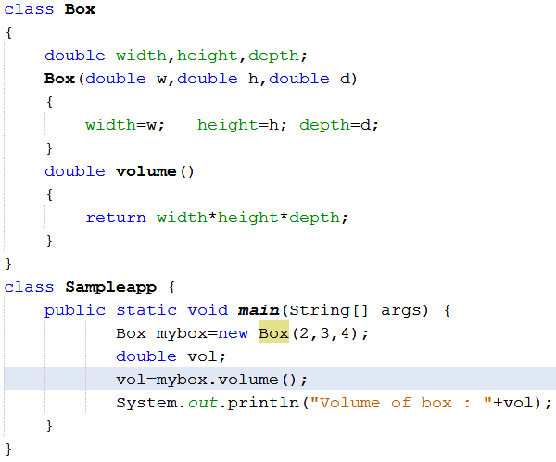
Q2 (Example of Parameterized Constructor)

Slide 34
Overloading
Overloading refers to the ability of a class to have multiple constructors or multiple methods with the same name but with different number or type of arguments list.
Overloading is a way by which java implements polymorphism.
There are two types :
  Method Overloading
  Constructor loading

Slide 35
Method Overloading
In Java it is possible to define two or more methods within the same class that share the same name, as long as their parameter declarations are different. This is called method overloading.
When an overloaded method is invoked, Java uses the type and/or number of arguments as its guide to determine which version of the overloaded method to actually call.
While overloaded methods may have different return types, the return type alone is insufficient to distinguish two versions of a method.
Q)Write a program to display a character, integer number and a floating point number using the concept of method overloading

Slide 36
class DisplayOverloading2 {
public void disp(char c)
{
System.out.println(c);
}
public void disp(int c)
{
System.out.println(c );
}
public void disp(float c)
{
System.out.println(c );
} }
class Sample2{
public static void main(String args[])
{
DisplayOverloading2 obj = new DisplayOverloading2();
obj.disp('a');
obj.disp(5); o/p a
obj.disp(2.5f); 5
} } 2.5

Slide 37
Constructor Overloading
Constructor methods can also be overloaded
class Box { double width, height,depth; Box(double w, double h, double d) { width = w; height = h; depth = d; } Box() { width = -1; height = -1; depth = -1; } Box(double len) { width = height = depth = len; } double volume() { return width * height * depth; } }
class OverloadCons { public static void main(String args[]) { Box mybox1 = new Box(10, 20, 15); Box mybox2 = new Box(); Box mycube = new Box(7); double vol; vol = mybox1.volume(); System.out.println("Volume of mybox1 is " + vol); vol = mybox2.volume(); System.out.println("Volume of mybox2 is " + vol); vol = mycube.volume(); System.out.println("Volume of mycube is " + vol); /* o/p Volume of mybox1 is 3000.0 } Volume of mybox2 is -1.0 } Volume of cube is 343.0 */

Slide 38
this Keyword
In Java, “this” is a reference variable that always refers to the current object. “this” can be used to resolve any name space collisions that might occur between instance variables and local variables.
We can use “this” keyword as follows:
in the current class to
  1.refer to the instance variable
  2.invoke the constructor
  3.invoke the method
can be passed as an argument in a method call
can be passed as an argument in a constructor call
to return the current class instance

Slide 39
1) this: to refer current class instance variable (Problem if we don’t use ‘this’)
class Student{
int rollno;
String name;
Student(int rollno,String name){
rollno=rollno;
name=name; }
void display(){System.out.println(rollno+" "+name);}
}
class TestThis1{
public static void main(String args[]){
Student s1=new Student(111,"ankit");
Student s2=new Student(112,"sumit");
s1.display(); o/p 0 null
s2.display(); 0 null
}}

Slide 40
1) this: to refer current class instance variable (Solution using ‘this’)
class Student{
int rollno;
String name;
Student(int rollno,String name){
this.rollno=rollno;
this.name=name; }
void display(){System.out.println(rollno+" "+name);}
}
class TestThis1{
public static void main(String args[]){
Student s1=new Student(111,"ankit");
Student s2=new Student(112,"sumit");
s1.display(); o/p 111 ankit
s2.display(); 112 sumit
}}

Slide 41
2) this: to invoke current class method (Example 1)
class Test {
void display()
{
// calling function show()
this.show();
System.out.println("Inside display function");
}
void show() {
System.out.println("Inside show funcion");
}
public static void main(String args[]) {
Test t1 = new Test();
t1.display();
} o/p Inside show funcion
} Inside display function

Slide 42
3) this() : to invoke current class constructor (Example 1)
/*The this() constructor call can be used to invoke the current class constructor. It is used to reuse the constructor. In other words, it is used for constructor chaining.*/
class A{
A()
{ System.out.println("hello a"); } o/p hello a
A(int x){ 10
this();
System.out.println(x);
}
}
class TestThis5{
public static void main(String args[]){
A a=new A(10);
}}

Slide 43
Access Control
The job of access specifier is to specify the scope of a variable (data member), function (method), constructor or any class.
Access specifiers in Java are :
  Public : This member can be accessed by any other code
  Private : This member can only be accessed by other members of its class.
  Protected : It is applied only when inheritance is involved.
  Default: Members of the same class as well as members of a different class within the same package can access the default members.
When no access specifier is used, then by default the member of a class is public within its own package, but cannot be accessed outside of its package.

Slide 44
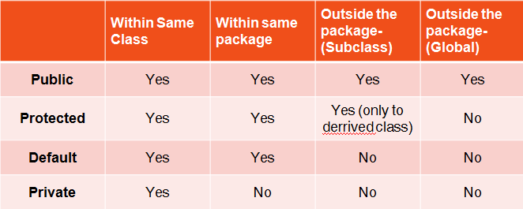

Slide 45
class Test { int a; public int b; private int c; void setc(int i) { c = i; } int getc() { return c; } }
class AccessTest { public static void main(String args[]) { Test ob = new Test(); // These are OK, a and b may be accessed directly ob.a = 10; ob.b = 20; // This is not OK and will cause an error // ob.c = 100; // Error! // You must access c through its methods ob.setc(100); // OK System.out.println("a, b, and c: " + ob.a + " " + ob.b + " " + ob.getc()); } }

Slide 46
Tutorial 4
1. Write a java program to design a class to represent a bank account. Include the following members:
Data members: name of depositor, Account number, Type of Account, Balance amount in account.
Methods : To assign initial values(use constructor), To deposit an amount, To withdraw an amount after checking balance, To display the name and balance.
2. Is there error in the following code. If yes then correct it.
public class Figure
{
public String draw(String s){
return “figure drawn”; }
public void draw(String s){}
public void draw(double f){}
}

Slide 47
static keyword
When a member is declared static, it can be accessed before any objects of its class are created, and without reference to any object.
Example : main( )
Variables, methods, blocks and nested classes can be declared as static.
Example : static int i;
static void add(){ ……. }
Instance variables declared as static are, essentially, global variables.
When objects of its class are declared, no copy of a static variable is made. Instead, all instances of the class share the same static variable.
Advantage – Makes the program memory efficient.

Slide 48
Advantage of static variable (Memory efficient)
class Student{ int rollno; String name; String college=“VJC"; } Student(int r, String n,String c) { rollno = r; name = n; college=c; } } public class TestStaticVariable1{ public static void main(String args[]){ Student s1 = new Student(111,“Amy“,”VJC”) Student s2 = new Student(222,"Anu“,”VJC”); }}
class Student{ int rollno; String name; static String college=“VJC"; } Student(int r, String n) { rollno = r; name = n; } } public class TestStaticVariable1{ public static void main(String args[]){ Student s1 = new Student(111,“Amy“); Student s2 = new Student(222,"Anu“); }}

Slide 49
Properties of static Methods :
  They can only call other static methods.
  They must only access static data.
  They cannot refer to this or super in any way.
Syntax for calling static methods and variables from outside of the class is : classname.method( ); //access static methods
classname.var_name ; //access static variables
Static block : It is defined inside a class and can be used to initialize static variables, which gets executed exactly once, when the class is first loaded before main.
Syntax : static
{…………
}

Slide 50
Example 1 class StaticDemo { static int a = 42; static int b ; static { b=a*2; } static void callme() { System.out.println("a = " + a); } } class StaticByName { public static void main(String args[]) { StaticDemo.callme(); System.out.println("b = " + StaticDemo.b); } }

Slide 51
Example 2
class Staticdemo{
public static void main(String args[])
{
Counter c1=new Counter();
c1.incrementCounter();
Counter c2=new Counter();
c2.incrementCounter();
} }
class Counter{
static int c=0;
public void incrementCounter(){
c++;
System.out.println(c); o/p 1
} } 2

Slide 52
Example 3(static block)
class Staticblock {
static int a=10;
static int b;
static{ //static block
System.out.println("Static block");
b=a*4;
}
public static void main(String args[])
{
System.out.println("from main");
System.out.println("Value of a : "+a+ "and b : " +b);
}
} o/p Static block
from main
Value of a: 10 and b: 40

Slide 53
Example 4(static nested class)
public class Outer {
static class Nested_Demo {
public void my_method()
{
System.out.println("This is my nested class");
}
} o/p This is my nested class
public static void main(String args[])
{
Outer.Nested_Demo nested = new Outer.Nested_Demo();
nested.my_method();
} }/* You cannot use the static keyword with a class unless it is an inner class. A static inner class is a nested class which is a static member of the outer class. It can be accessed without instantiating the outer class, using other static members. */

Slide 54
final Variables
The final keyword in java is used to restrict the user. The java final keyword can be used in many context. Final can be:
1. variable
2. method
3. class
A final variable that have no value is called blank final variable or uninitialized final variable. It can be initialized in the constructor only. The blank final variable can be static also which will be initialized in the static block only.

Slide 55
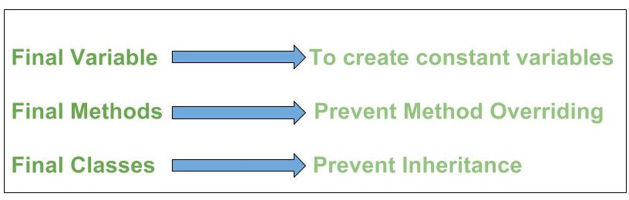

Slide 56
Final variables
If a variable is declared with the final keyword, its value cannot be changed once initialized.
Example
class ExFinalVariable
{
final int var = 50;
var = 60 //This line would give an error
}

Slide 57
Final methods
A method, declared with the final keyword, cannot​ be overridden or hidden by subclasses.
Example
class Base{
public final void finalMethod(){
System.out.print("Base");
} }
class Derived extends Base{
public final void finalMethod() { //Overriding the final method throws an
error
System.out.print("Derived");
}
}

Slide 58
Final classes
A class​ declared as a final class, cannot be subclassed
Example
// declaring a final class
final class FinalClass {
//...
}
class Subclass extends FinalClass
{ //attempting to subclass a final class throws an error
//...
}

Slide 59
Final Variables, Methods and Classes
The keyword final has three uses.
  Equivalent to named constants :
    The value of the final variable can never be changed.
    Final variables behave like class variables and they do not take any space on individual objects of the class.
    Example : final int size=100;
  To Prevent Overriding :
    To prevent the subclasses from overriding the members of the super class, we can declare them as final in its super class using the keyword final.
  To Prevent Inheritance :
    Precede the class declaration with final.
    Declaring a class as final implicitly declares all of its methods as final, too.
    It is illegal to declare a class as both abstract and final

Slide 60
Inner classes
In Java, just like methods, a class too can have another class as its member.The class written within is called the nested class, and the class that holds the inner class is called the outer class.
Nested classes are divided into two types −
Inner classes or Non-static nested classes − These are the non-static members of a class.
Static nested classes − These are the static members of a class.

Slide 61
Example – inner classes(non-static nested classes)
class Outer {
// Simple nested inner class
class Inner {
public void show() {
System.out.println("In a nested class method");
}
}
}
class Nested {
public static void main(String[] args) {
Outer.Inner in = new Outer().new Inner();
in.show(); o/p In a nested class method
} }

Slide 62
Java Command line argument
The command line argument is the argument that passed to a program during runtime.
It is the way to pass argument to the main method in Java.
These arguments store into the String type args parameter which is main method parameter.
To access these arguments, you can simply traverse the args parameter in the loop or use direct index value because args is an array of type String.

Slide 63
Example
class Cmdline
{
public static void main(String[] args)
{
for(int i=0;i< args.length;i++)
{
System.out.println(args[i]);
} //To run the program - java Cmdline hello world
} o/p hello
} world

Slide 64
Variable Length Argument (Varargs)
The varargs allows the method to accept zero or muliple arguments.
Variable length arguments are most useful when the number of arguments to be passed to the method is not known beforehand.
Variable number of arguments are represented by three dotes (…)
Advantage of Varargs:
We don't have to provide overloaded methods, so less code.

Slide 65
Example 1
class Varagex1{
int sum(int...num) {
int total=0;
for(int x:num)
{
total=total+x;
}
return total;
}
public static void main(String args[]){
int s;
Varagex1 e=new Varagex1();
s=e.sum(1,2,3);
System.out.println(“The sum is “ +s);
} } o/p The sum is 6

Slide 66
Example 2
class Demo{
public static void Varar(String...str)
{
System.out.println("num of args" +str.length);
System.out.println("The arguments are ");
for(String a:str)
System.out.println(a); o/p num of args 2
} The arguments are
public static void main(String args[]) Apple
{ mango
Varar("Apple","mango"); num of args 1
Varar("Pear"); The arguments are
} Pear
}

Slide 67
Recursion in Java
Recursion in java is a process in which a method calls itself continuously. A method in java that calls itself is called recursive method.
It makes the code compact.

Slide 68
Example 1: Factorial
public class RecursionExample {
static int factorial(int n){
if (n == 1)
return 1;
else
return(n * factorial(n-1));
}
public static void main(String[] args) {
System.out.println("Factorial of 5 is: "+factorial(5));
}
}

Slide 69
Working of above program:
factorial(5)
factorial(4)
factorial(3)
factorial(2)
factorial(1)
return 1
return 2*1 = 2
return 3*2 = 6
return 4*6 = 24
return 5*24 = 120

Slide 70
Example 2: Fibonacci Series
public class RecursionExample { static int n1=0,n2=1,n3=0; static void printFibo(int count){ if(count>0){ n3 = n1 + n2; n1 = n2; n2 = n3; System.out.print(" "+n3); printFibo(count-1); } }
public static void main(String[] args) { int count=5; System.out.print(n1+" "+n2);//printing 0 and 1 printFibo(count-2); //count-2 because 2 numbers are already printed } } o/p 0 1 1 2 3

Slide 71
Arrays
An array is a group of like-typed variables that are referred to by a common name. Arrays of any type can be created and may have one or more dimensions. A specific element in an array is accessed by its index.
One-Dimensional Arrays
A one-dimensional array is a list of like-typed variables. In Java all arrays are dynamically allocated.
Declaration and memory allocation can be done in Two steps
First, declare a variable of the desired array type. Second, allocate the memory that will hold the array, using new (special operator that allocates memory), and assign it to the array variable.
Syntax 1: Example
type var-name[ ]; int month_days[];
var-name = new type[size]; month_days = new int[12];

Slide 72
Syntax 2: Example
type[] var-name; int[] month_days;
var-name = new type[size]; month_days = new int[12];
It is possible to combine the declaration of the array variable with the allocation ofthe array itself
Syntax 1: Example
type var-name[ ] = new type[size]; int month_days[] = new int[12];
Syntax 2:
type[] var-name = new type[size]; int[] month_days = new int[12];
Arrays can be initialized when they are declared. An array initializer is a list of comma-separated expressions surrounded by curly braces.
Eg) int month_days[] = { 31, 28, 31, 30, 31, 30, 31, 31, 30, 31, 30, 31 };

Slide 73
Example
// Average an array of values.
class Average
{
public static void main(String args[])
{
double nums[] = {10.1, 11.2, 12.3, 13.4, 14.5};
double result = 0;
int i;
for(i=0; i<5; i++)
result = result + nums[i];
System.out.println("Average is " + result / 5);
}
}

Slide 74
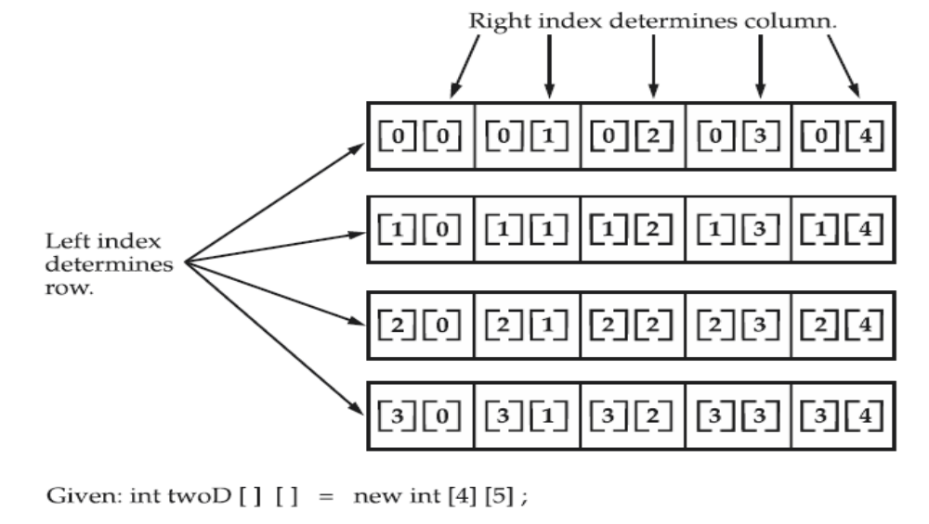
Multidimensional Arrays
In Java, multidimensional arrays are actually arrays of arrays.
Declaration Example :
int twoD[][] = new int[4][5]; OR int[][] twoD = new int[4][5];
This allocates a 4 by 5 array and assigns it to twoD.

Slide 75
Example: Print the elements in the matrix
class TwoDArray{
public static void main(String args[]) {
int twoD[][]= new int[4][5];
int i, j, k = 0;
for(i=0; i<4; i++)
for(j=0; j<5; j++) {
twoD[i][j] = k;
k++; }
for(i=0; i<4; i++) {
for(j=0; j<5; j++)
System.out.print(twoD[i][j] + " ");
System.out.println(); }
} }

Slide 76
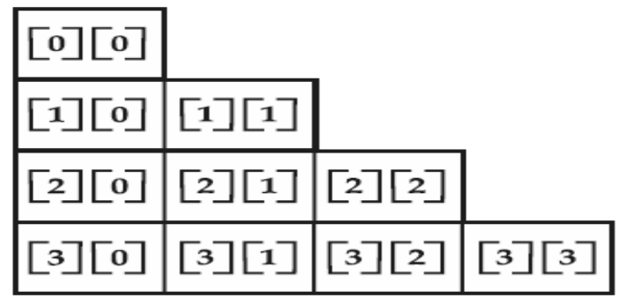
When you allocate memory for a multidimensional array, we need only specify the memory for the first (leftmost) dimension. we can allocate the remaining dimensions separately.
Example
int twoD[][] = new int[3][]; This is how the array looks like
twoD[0] = new int[1];
twoD[1] = new int[2];
twoD[2] = new int[3];
It is possible to initialize multidimensional arrays. To do so, simply enclose each dimension’s initializer within its own set of curly braces.
Expressions as well as literal values can be used inside array initializer.
Example int m[][] = { { 0, 1, 2, 3 },
{ 4, 5, 6, 7 },
{8,9,10,11} };

Slide 77
Vector class
Vector implements a dynamic array that means it can grow or shrink as required.
Like an array, it contains components that can be accessed using an integer index.
It can hold objects of any type and any number.
Vector class is contained in java.util package.
It is similar to ArrayList, but with two differences −
  1. Vector is synchronized.
  2. Vector contains many legacy methods that are not part of the collections framework.
It extends AbstractList and implements List interfaces.

Slide 78
Vector proves to be very useful if you don't know the size of the array in advance or you just need one that can change sizes over the lifetime of a program.
Constructors of Vector – Vector class provides 4 constructors
1. Vector(): Creates a default vector of initial capacity is 10.
2. Vector(int size): Creates a vector whose initial capacity is specified by size.
3. Vector(int size, int incr): Creates a vector whose initial capacity is specified by size and increment is specified by incr. It specifies the number of elements to allocate each time that a vector is resized upward.
4.Vector(Collection c): Creates a vector that contains the elements of collection c.

Slide 79
Important points regarding Increment of vector capacity:
If increment is specified, Vector will expand according to it in each allocation cycle but if increment is not specified then vector’s capacity get doubled in each allocation cycle. Vector defines three protected data member:
int capacityIncreament: Contains the increment value.
int elementCount: Number of elements currently in vector stored in it.
Object elementData[]: Array that holds the vector is stored in it.

Slide 80
Methods in Vector:
boolean add(Object obj): This method appends the specified element to the end of this vector.
Example
import java.util.*;
class Vector_demo {
public static void main(String[] arg)
{
Vector v = new Vector(); // create default vector
v.add(1);
v.add(2);
v.add(“hello");
v.add(“world");
v.add(3);
System.out.println("Vector is " + v);
} }
o/p Vector is [1, 2, hello, world, 3]

Slide 81
void add(int index, Object obj): This method inserts the specified element at the specified position in this Vector.
Example
import java.util.*;
class Vector_demo {
public static void main(String[] arg) {
Vector v = new Vector(); // create default vector
v.add(0, 1);
v.add(1, 2);
v.add(2, “hello");
v.add(3, “world");
v.add(4, 3);
System.out.println("Vector is " + v);
}
}
Output:
Vector is: [1, 2, hello, world, 3]

Slide 82
Commonly used methods of Vector Class:
void addElement(Object element): It inserts the element at the end of the Vector.
int capacity(): This method returns the current capacity of the vector.
int size(): It returns the current size of the vector.
void setSize(int size): It changes the existing size with the specified size.
boolean contains(Object element): This method checks whether the specified element is present in the Vector. If the element is been found it returns true else false.
boolean containsAll(Collection c): It returns true if all the elements of collection c are present in the Vector.
Object elementAt(int index): It returns the element present at the specified location in Vector.
Object firstElement(): It is used for getting the first element of the vector.
Object lastElement(): Returns the last element of the array.
Object get(int index): Returns the element at the specified index.

Slide 83
Contd..
boolean isEmpty(): This method returns true if Vector doesn’t have any element.
boolean removeElement(Object element): Removes the specifed element from vector.
boolean removeAll(Collection c): It Removes all those elements from vector which are present in the Collection c.
void setElementAt(Object element, int index): It updates the element of specifed index with the given element.

